Slide 1
INTRODUCTION TO ICT
AND GENERAL CONCEPTS
By Humphrey Kumwembe

Slide 2
OBJECTIVES
At the end of this lesson you should be able to:
  Define the term ICT
  Differentiate the terms data and information.
  Identify system stages
  Define a computer as a system
  Identify the main components of a computer.

Slide 3
What is ICT
ICT Stands for Information and Communications Technology, it is the study or business of developing and using technology to process data and aid communications.
The subject of ICT encompasses any technology that allows us to process data and to communicate.
Technology encompasses communication devices and applications i.e. Cellular phone, Satellite systems, Computers and network hardware and software.
It is used in almost all sectors i.e. Health, Education, Military, finance

Slide 4
Data
Data is a collection of unprocessed items, which can include text, numbers, images, audio, and video.
Examples: M, 201350047823, 20, 3.1415927, +++,@.
Data values do not have any meaning unless they are put in a context(Setting or circumstance).
I.e 20 above does not have any meaning.

Slide 5
Information
Data that is accurate and timely, specific and organized for a purpose, presented within a context that gives it meaning and relevance, and can lead to an increase in understanding and decrease in uncertainty.
Example: 201350047823 if applied at College of Medicine will be a registration number.

Slide 6
Systems
For one to understand ICT, there is need to understand what a system.
Comprised of 3 stages:
  Input – Data fed into a system
  Process – System process data and convert it to a product.
  Output – Product is then shown through different forms
Examples: Digestive system, Inspiratory system.

Slide 7

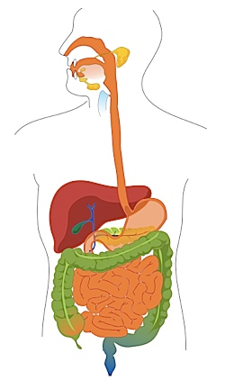
Systems cont…

Slide 8
Computer System
A computer is an electronic device, operating under the control of instructions stored in its own memory, that can accept data, process the data according to specified rules, produce
results, and store the results for future use..
Comprised of 4 stages:
  INPUT– Data fed into a computer system
  INSTRUCTIONS: Steps that tells a computer how to perform a particular task. A collection of related instructions organized for a particular purpose is referred to as SOFTWARE
  OUTPUT: The processed data is the converted into a product called information.
  STORAGE: Data or information or instructions can later be stored within or outside of the computer for future use.

Slide 9

Computer System cont..
The series of input, process, output and storage activities is referred to Information Processing Cycle.

Slide 10
Components of a Computer
A computer contains many electric, electronic, and mechanical components known as hardware.
The components include:
  Input devices
  Output devices
  System unit
  Storage devices
  Communication devices

Slide 11
Components of a Computer(Conti..)
An input device is any hardware component that allows you to enter data and instructions into a computer.
Examples include:
  Keyboard: Contains keys you press to enter data into the computer
  Mouse: A small handheld device, that controls the movement of small symbol called pointer and you make selections from the screen.
  Scanner: Converts printed material into a form a computer can use.
  Webcam: A digital camera that allows you to create movies or take pictures and store them on the computer
  Microphone: Allows you to speak into the computer.

Slide 12
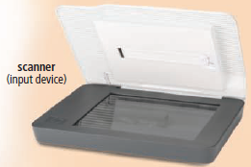



Components of a Computer(Conti..)
Input Devices
Webcam
Microphone

Slide 13
Components of a Computer(Conti..)
An output device is any hardware component that conveys information to one or more people.
Examples include:
  Printer: Produces text and graphics on the physical medium i.e. paper.
  Monitor: Displays text, graphics and videos on a screen.
  Speakers: Allows you to hear music, voice and other audios.

Slide 14
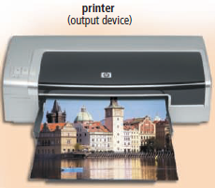
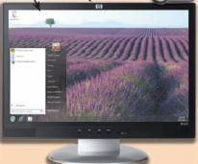

Components of a Computer(Conti..)
Output Devices
Monitor
Speaker

Slide 15
Components of a Computer(Cont..)
System unit case containing the electronic components of a computer that is used to process data.
The circuitry of the system unit usually is part of or is connected to a circuit board called the motherboard.
Motherboard has two main components:
  Central processing unit(CPU)/Processor: Electronic component that interprets and caries out basic instructions that operate the computer. It is also called the brain of the computer.
  Memory: Electronic components that store instructions waiting to be executed and data needed by those instructions.

Slide 16
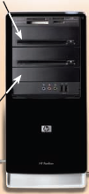
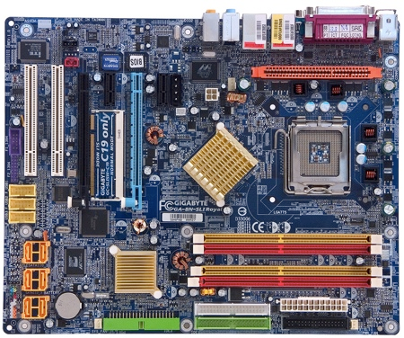
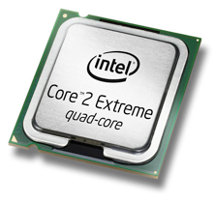
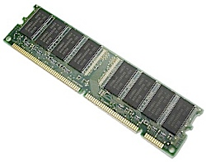
Components of a Computer(Conti..)
System Unit
System unit
Central Processing Unit
Motherboard
Memory

Slide 17
Components of a Computer(Cont..)
Storage Devices: Storage holds data, instructions and information for future use.
Example computer can hold millions of student information.
Storage holds the items permanently.
The items are stored on a Storage Media.
Storage media examples include; USB flash drives, Hard drives, optical discs and memory cards.
Storage device records items to and from storage media.

Slide 18
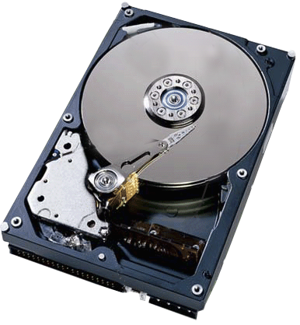
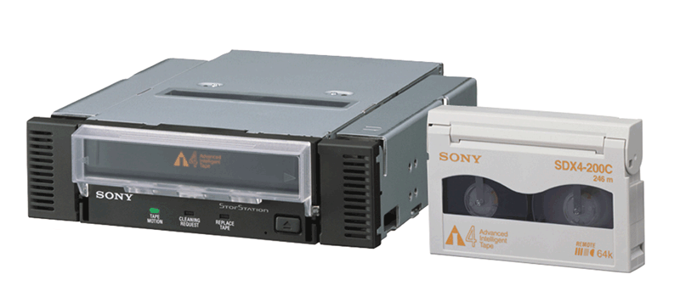
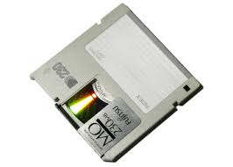
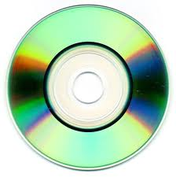
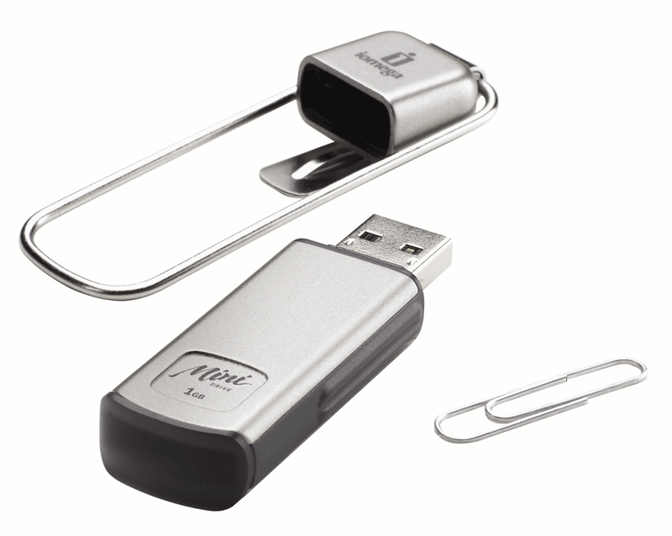

Components of a Computer(Conti..)
Storage Devices
hard disk
Tape
Hard disk
Floppy disk
USB Drive
Optical disk

Slide 19
Components of a Computer(Cont..)
Communications devices: Hardware component that enables a computer to send(transmit) and receive data, instructions and information to and from one or more computer or mobile devices.
Occurs over cables, telephone lines, cellular radio networks, satellites, and other transmission media
Example include Modem,Router, wi-fi cards, and Network interface cards.

Slide 20

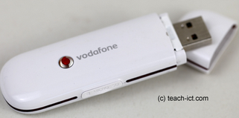
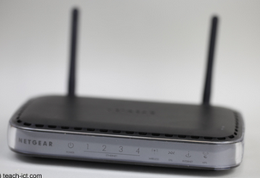
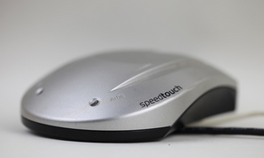
Components of a Computer(Conti..)
Communications devices
Network Interface card
Wi-Fi card
Router
Modem

